Slide 1
Mobile and Web Game Business Model
Course : Mobile and Web Game Programming
Effective Period : September 2018

Slide 2
These slides have been adapted from: Dr Penny de Byl. 2014. Holistic Mobile Game Development with Unity. FOCAL. Burlington. ISBN:978-0415839235 Chapter 1 and Fullerton, Tracy. (2008). GAME DESIGN WORKSHOP: A Playcentric Approach to Creating Innovative Games. Morgan Kaufman ISBN 978-0-240-80974-8
Acknowledgement

Slide 3
Learning Objectives
LO 1 : Apply best practices of mobile and web game development
LO 2 : Apply game design and marketing techniques to boost mobile game performance
LO 3 : Produce game in mobile and web platform
LO 4 : Design game monetization and business model

Slide 4
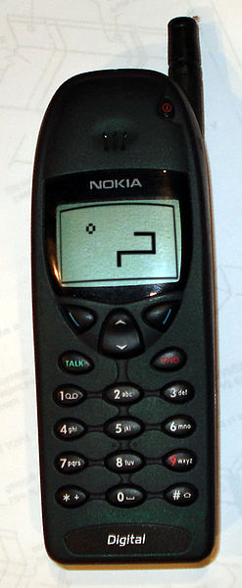
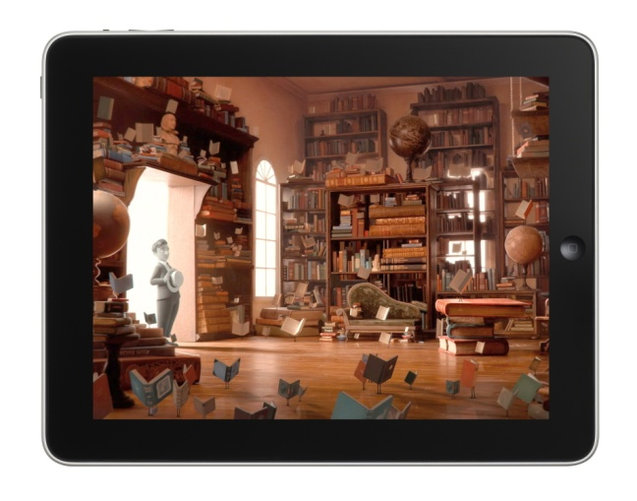
In the Beginning ...

Slide 5
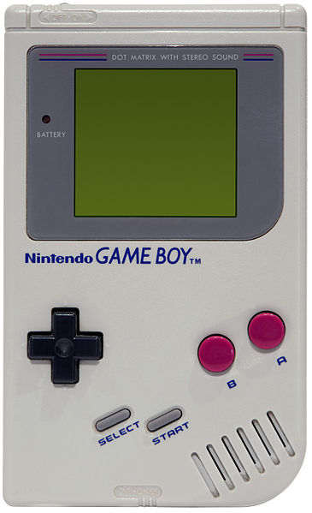
A Brief History of Mobile Video Games
LCD
Navigational Pad
Control Cross
Marketing and Players
Touchscreen
Game Delivery

Slide 6
A Brief History of Mobile Phone Games
The ‘casual gamer’ and the gameplay
The Rise of Mobile Architecture
Comparison for performance
ARM architecture
SoC
CPU and GPU clock speed

Slide 7
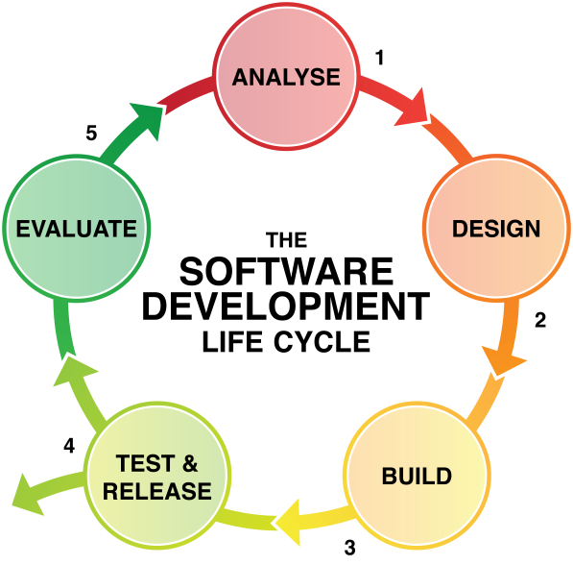
The Mobile Game Developer’s Handbook
Software Development Life Cycle (SDLC)

Slide 8
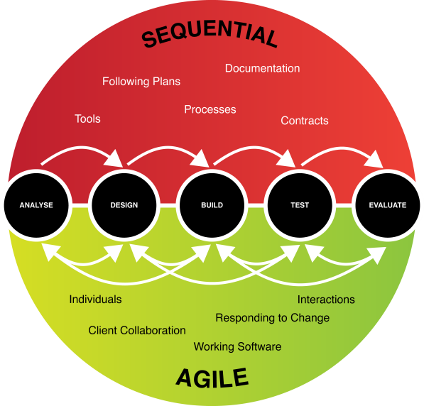
The Mobile Game Developer’s Handbook
Software Development Life Cycle (SDLC)

Slide 9
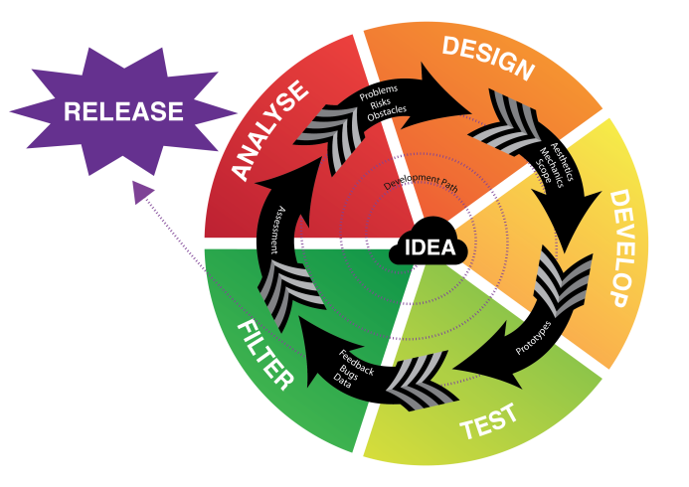
The Mobile Game Developer’s Handbook
A Game Development Life Cycle

Slide 10
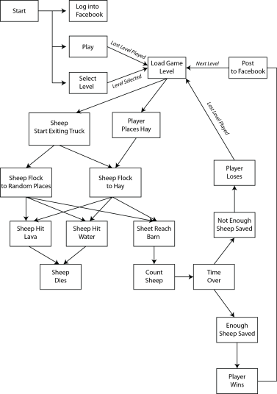
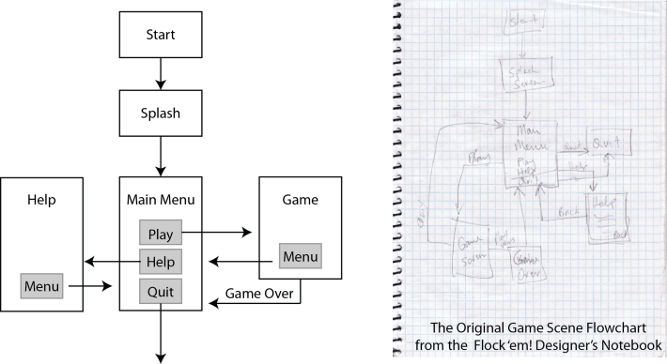
The Mobile Game Designer’s Notebook
The Paperwork
Flowcharts
“The realization of your idea taking shape on paper.”

Slide 11
The Mobile Game Designer’s Notebook
Development Checklist
Emulators
Integrated Development Environments (IDEs)
3D modelling/animation
Sound creation and manipulation
Third-party assets
Game engine
Development computer
External storage and backup
Version control

Slide 12
Let’s Talk Business
The Business Model Canvas, is a strategic management and entrepreneurial tool. It allows you to describe, design, challenge, invent, and pivot your business model. They have 9 elements which are
Customer Segments: Who are the customers? What do they think? See? Feel? Do?
Value Propositions: What’s compelling about the proposition? Why do customers buy, use?
Channels: How are these propositions promoted, sold and delivered? Why? Is it working?
Customer Relationships: How do you interact with the customer through their ‘journey’?
Revenue Streams: How does the business earn revenue from the value propositions?
Key Activities: What uniquely strategic things does the business do to deliver its proposition?
Key Resources: What unique strategic assets must the business have to compete?
Key Partnerships: What can the company not do so it can focus on its Key Activities?
Cost Structure: What are the business’ major cost drivers? How are they linked to revenue?
Source: http://www.alexandercowan.com/business-model-canvas-templates/

Slide 13
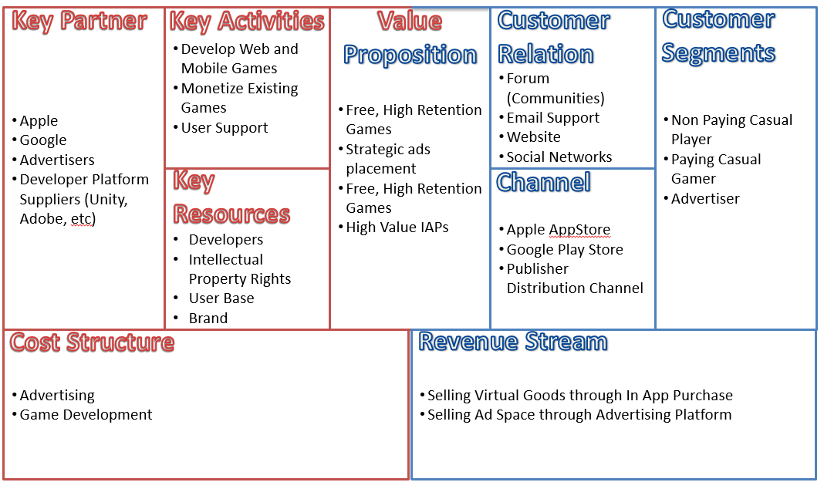
Example Business Model Canvas

Slide 14
Assignment
Create a business model canvas for your team based on the game that you are developing.

Slide 15
References
Fullerton, Tracy. (2008). GAME DESIGN WORKSHOP: A Playcentric Approach to Creating Innovative Games. Morgan Kaufman ISBN 978-0-240-80974-8

